Slide 1
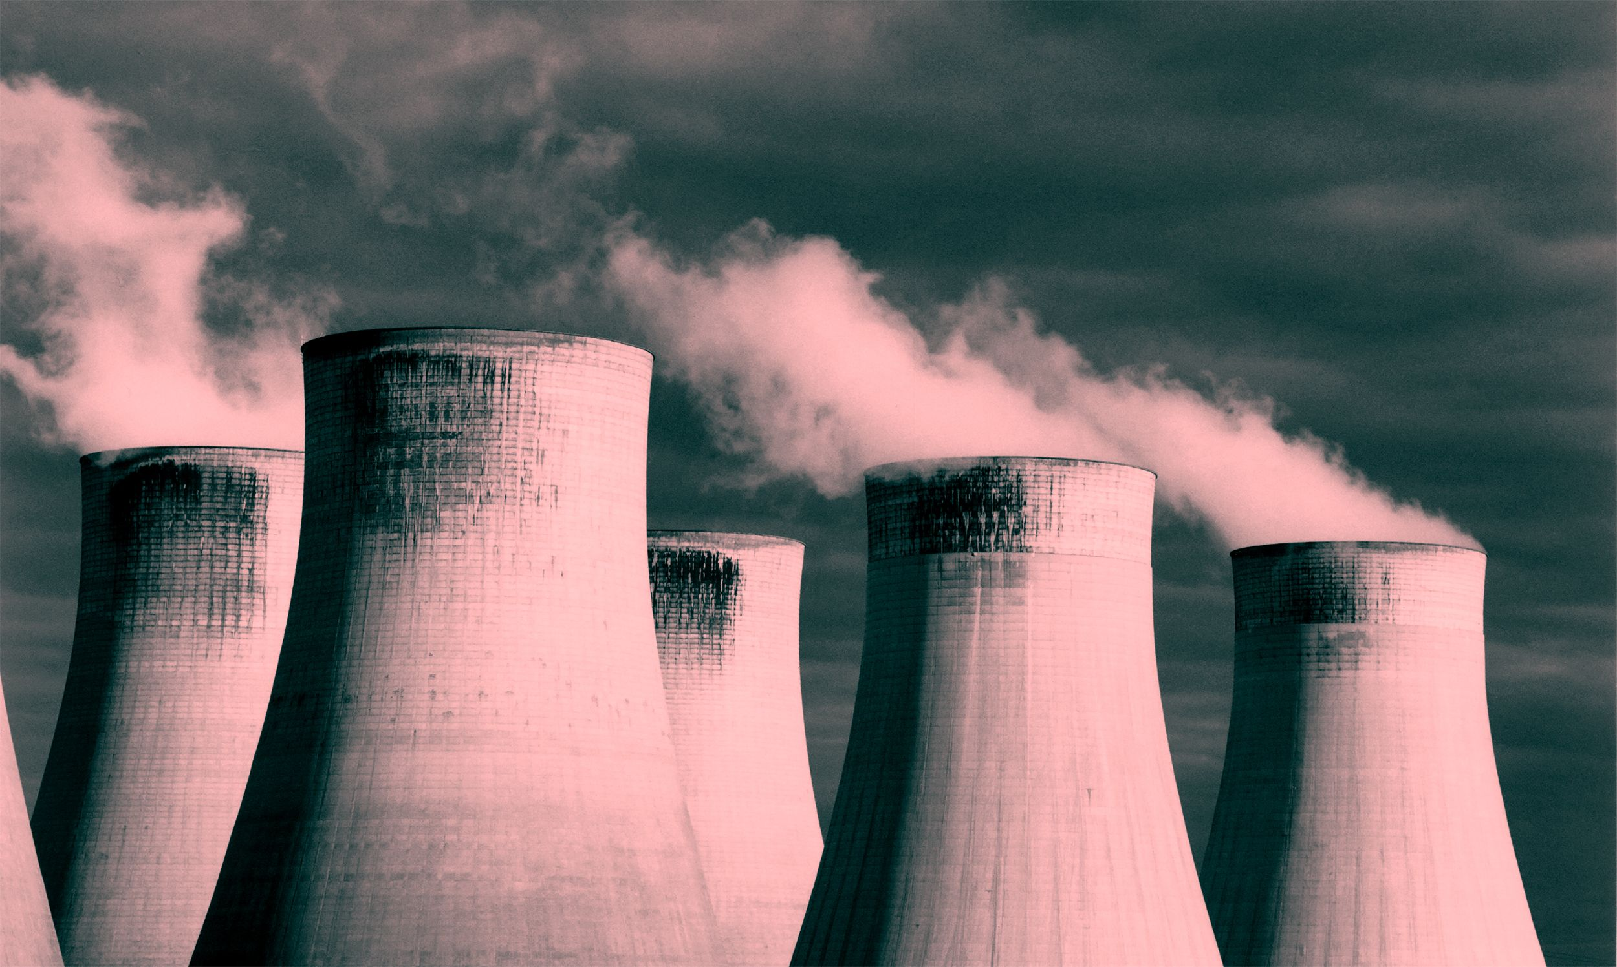
NUCLEAR ENERGY

Slide 2
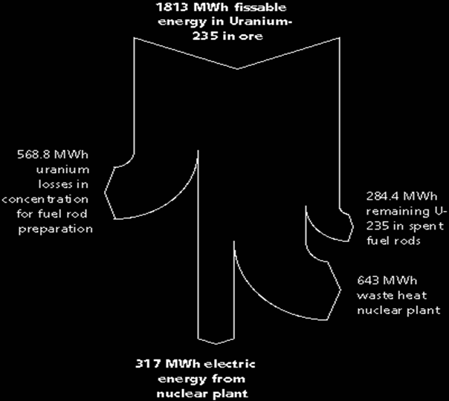
Sankey Diagram

Slide 3
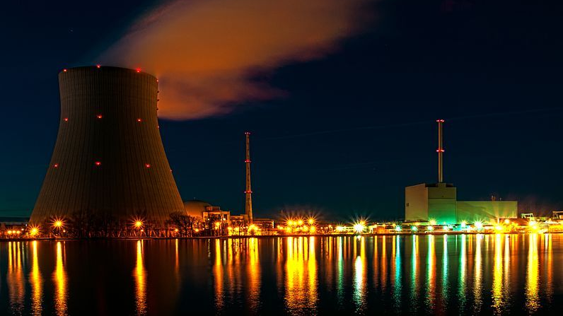
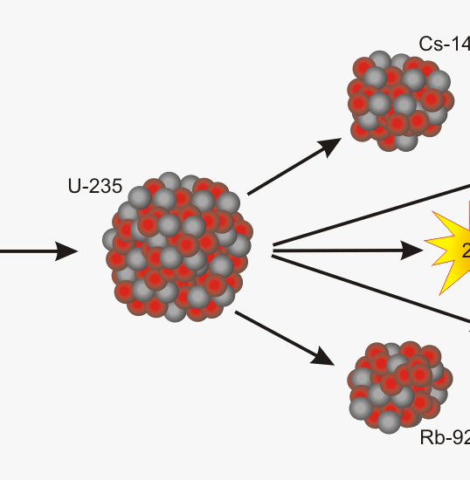
Nuclear energy --> Thermal energy-->Electricity
Basic process- uranium 235 is used to start a chain reaction, neutrons collide with particles in the moderator, kinetic energy turns into thermal energy. That energy is used to turn water into steam, the steam spins and turbine and creates electricity
U-235 is the isotope used to start the chain reaction

Slide 4
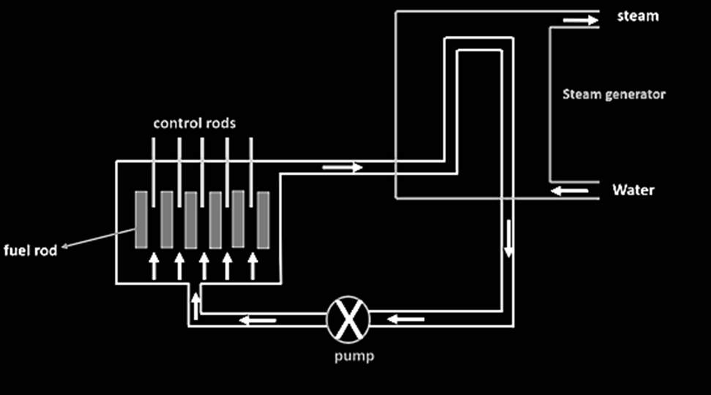
The control robs absorb neutrons to control the reactions. Too few and the reaction stops. Too many and it goes out of control
The uranium is kept in the fuel rods

Slide 5
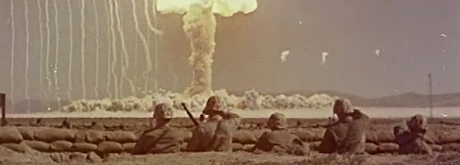
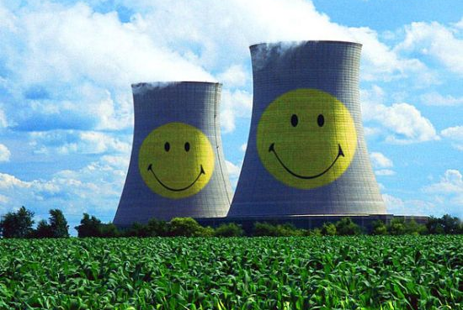
ADVANTAGES
High power output
Large reserves of nuclear fuels
Nuclear power stations do not produce greenhouse gases

Slide 6
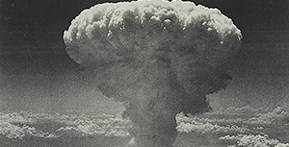
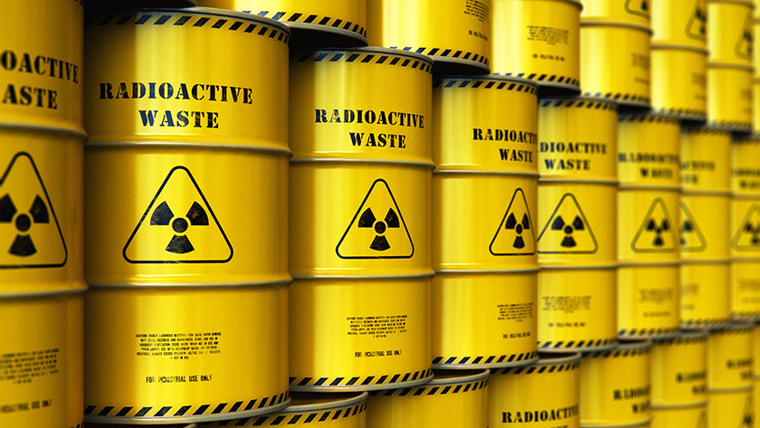
DISADVANTAGES
Radioactive waste products difficult to dispose of
Major public health hazard should 'something go wrong'
Problems associated with uranium mining
Possibility of producing materials for nuclear weapons.

Slide 7
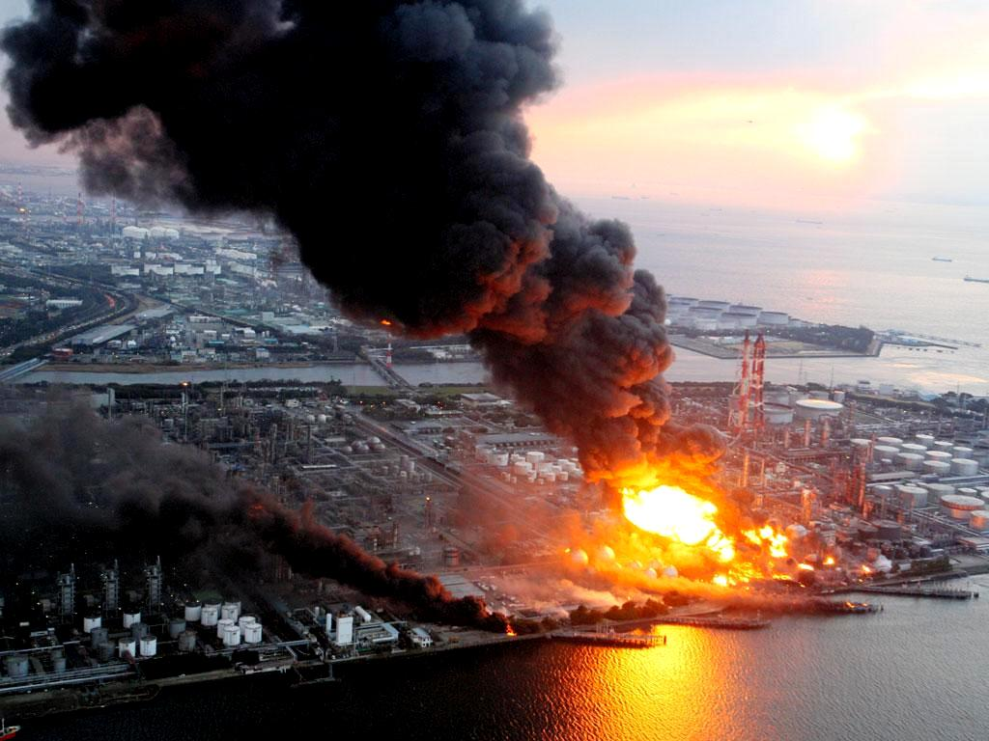
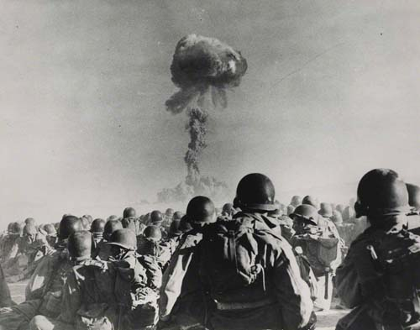
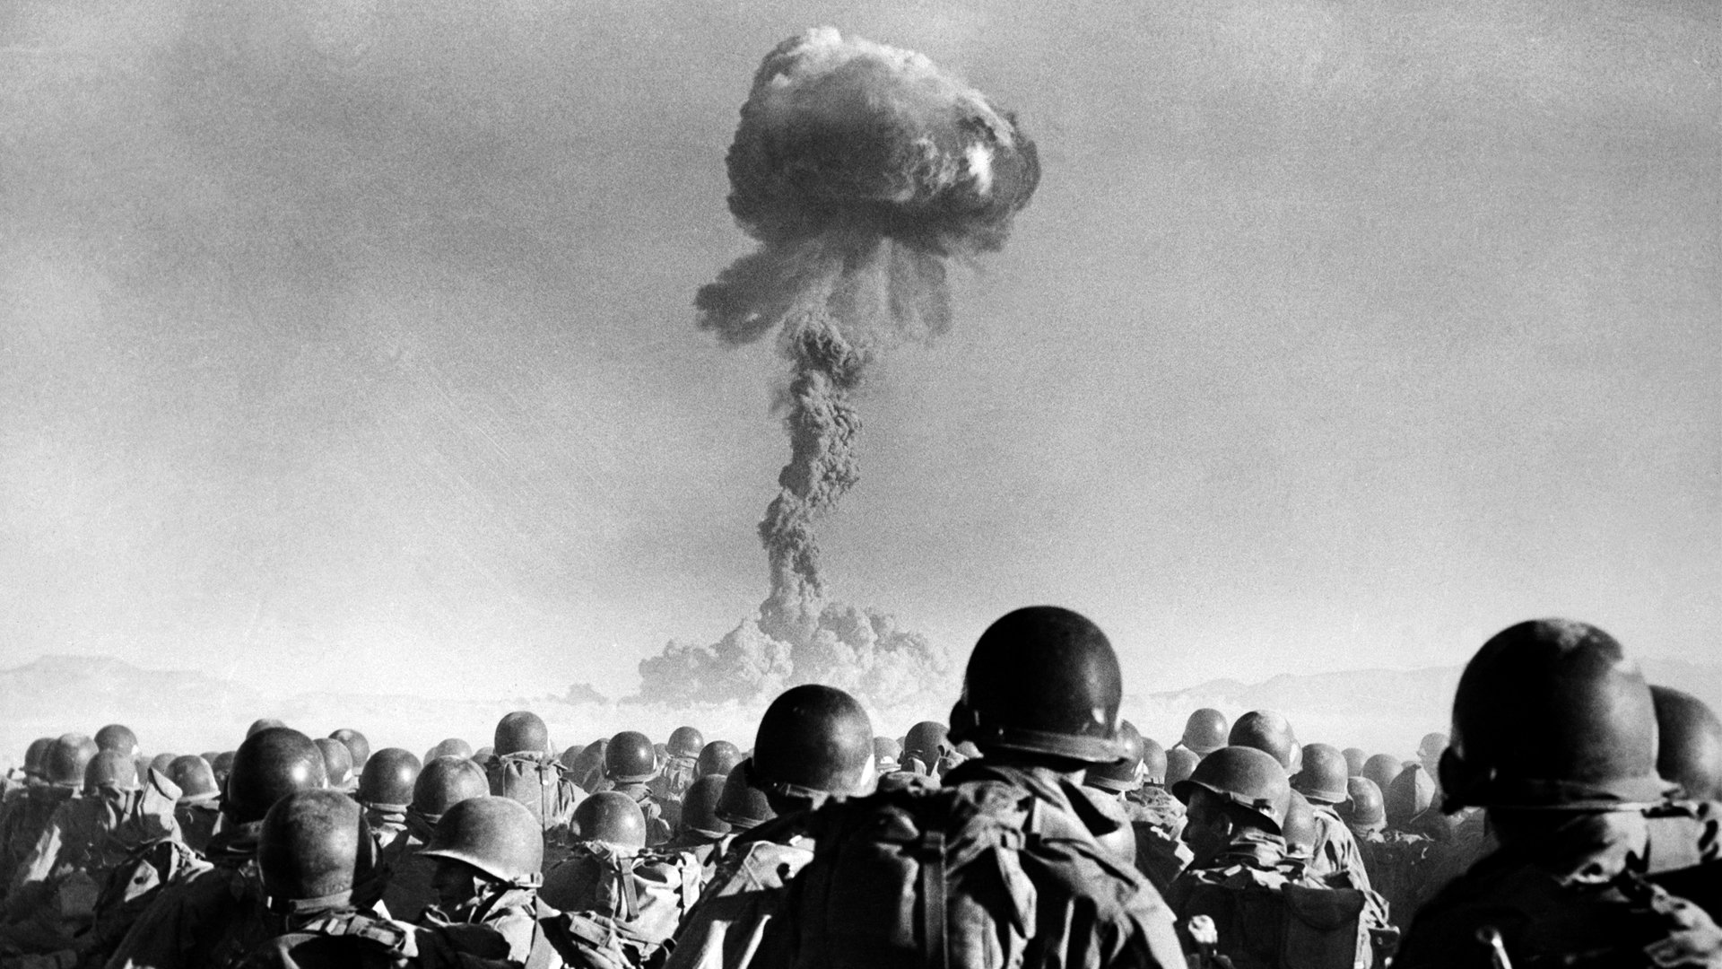
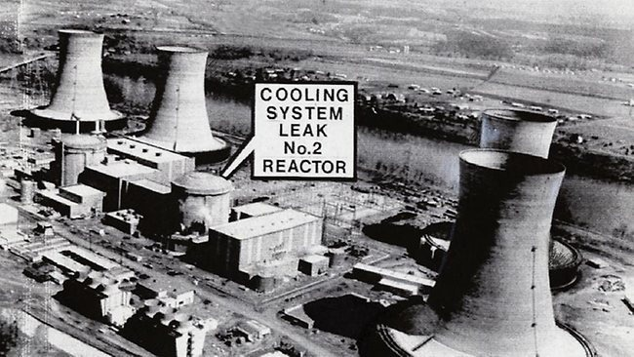
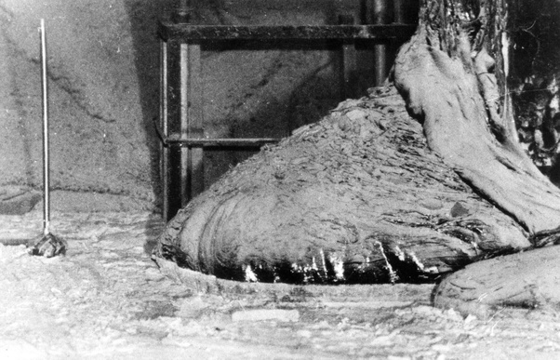
Safety Issues
United States nuclear testing, 1946-1992
Fukushima Daiichi nuclear disaster , 2011​
1979 Three Mile Island meltdown
Chernobyl nuclear plant , 1986

Slide 8
IMPORTANCE
Cost- in 2012, it costs about $96 per megawatt, nuclear power is expansive to produce because it's expensive to build and maintain a nuclear plant
Environmental impact- construction of the plant, fuel procurement and of the thermal load of the cooling water discharged into the sea during operation- similar to that of what wind, solar or hydropower.
International and cultural factors- Nuclear power has provided a focus for opposition to advanced technology, to centralization of decision-making and to other features of modern industrial society

Slide 9
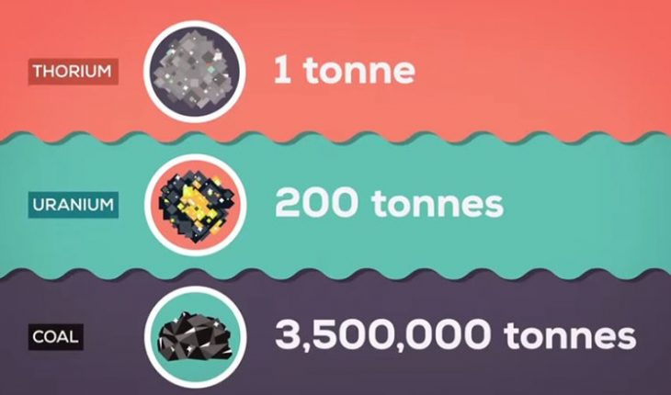
Thorium
Thorium will not by itself split and release energy
Thorium is rather fertile, but uranium-233 is fissile
Thorium is also a greener alternative, has lately been given an increased amount of attention. China, Russia and India have already planned to start using thorium to fuel their reactors in the near future.

Slide 10
Keys concepts on the homework
E = Δu
Energy = Atomic mass of Reactants - Atomic mass of Products
Atomic mass is measured with Atomic mass unit, u
1 u = 1 g/mol = 931.5 MeV
Energy is measured with Electronvolt, eV
1 eV = 1.6021766208(98)×10⁻¹⁹ J
1 MeV = 1.602 × 10⁻¹³ J

Slide 11
Textbook page 327, #7-11
Neutron moderator
1u is 931.5 MeV (mega electronvolt)
1 MeV= 1.6022x 10^-13
Calculate the energy released in the following spontaneous fission reaction:
²³⁸U → ⁹⁵Sr + ¹⁴⁰Xe + 3n
given the atomic masses to be
m(²³⁸U) = 238.050784 u
m(⁹⁵Sr) = 94.919388 u
m(¹⁴⁰Xe) = 139.921610 u
m(n) =1.008665 u

Slide 12
Sources
1) “U.S. Energy Information Administration - EIA - Independent Statistics and Analysis.” Nuclear Explained - U.S. Energy Information Administration (EIA), www.eia.gov/energyexplained/nuclear/.
2)Thorium - World Nuclear Association, www.world-nuclear.org/information-library/current-and-future-generation/thorium.aspx.
3) “Three Mile Island Accident.” Three Mile Island Accident, hcrusanthreemileislandaccident.weebly.com/.

